Slide 1
Technical Test
Han Wei Ryan Soh

Slide 2
Limitations
The different datasets from the different years are labeled differently.
From 1990 to 2012, the date recorded is approval date.
After 2012, the date recorded is registration date.
The differences in the dates might be affecting the subsequent calculations of the remaining lease.
Similarly lease_commence_date is also recorded only in years without month data, which further affects the calculation of remaining lease.

Slide 3
Assumptions
‘Multi Generation’ and ‘Multi-Generation’ is the same thing for flat_type.
Lease date starts in January of the year.

Slide 4
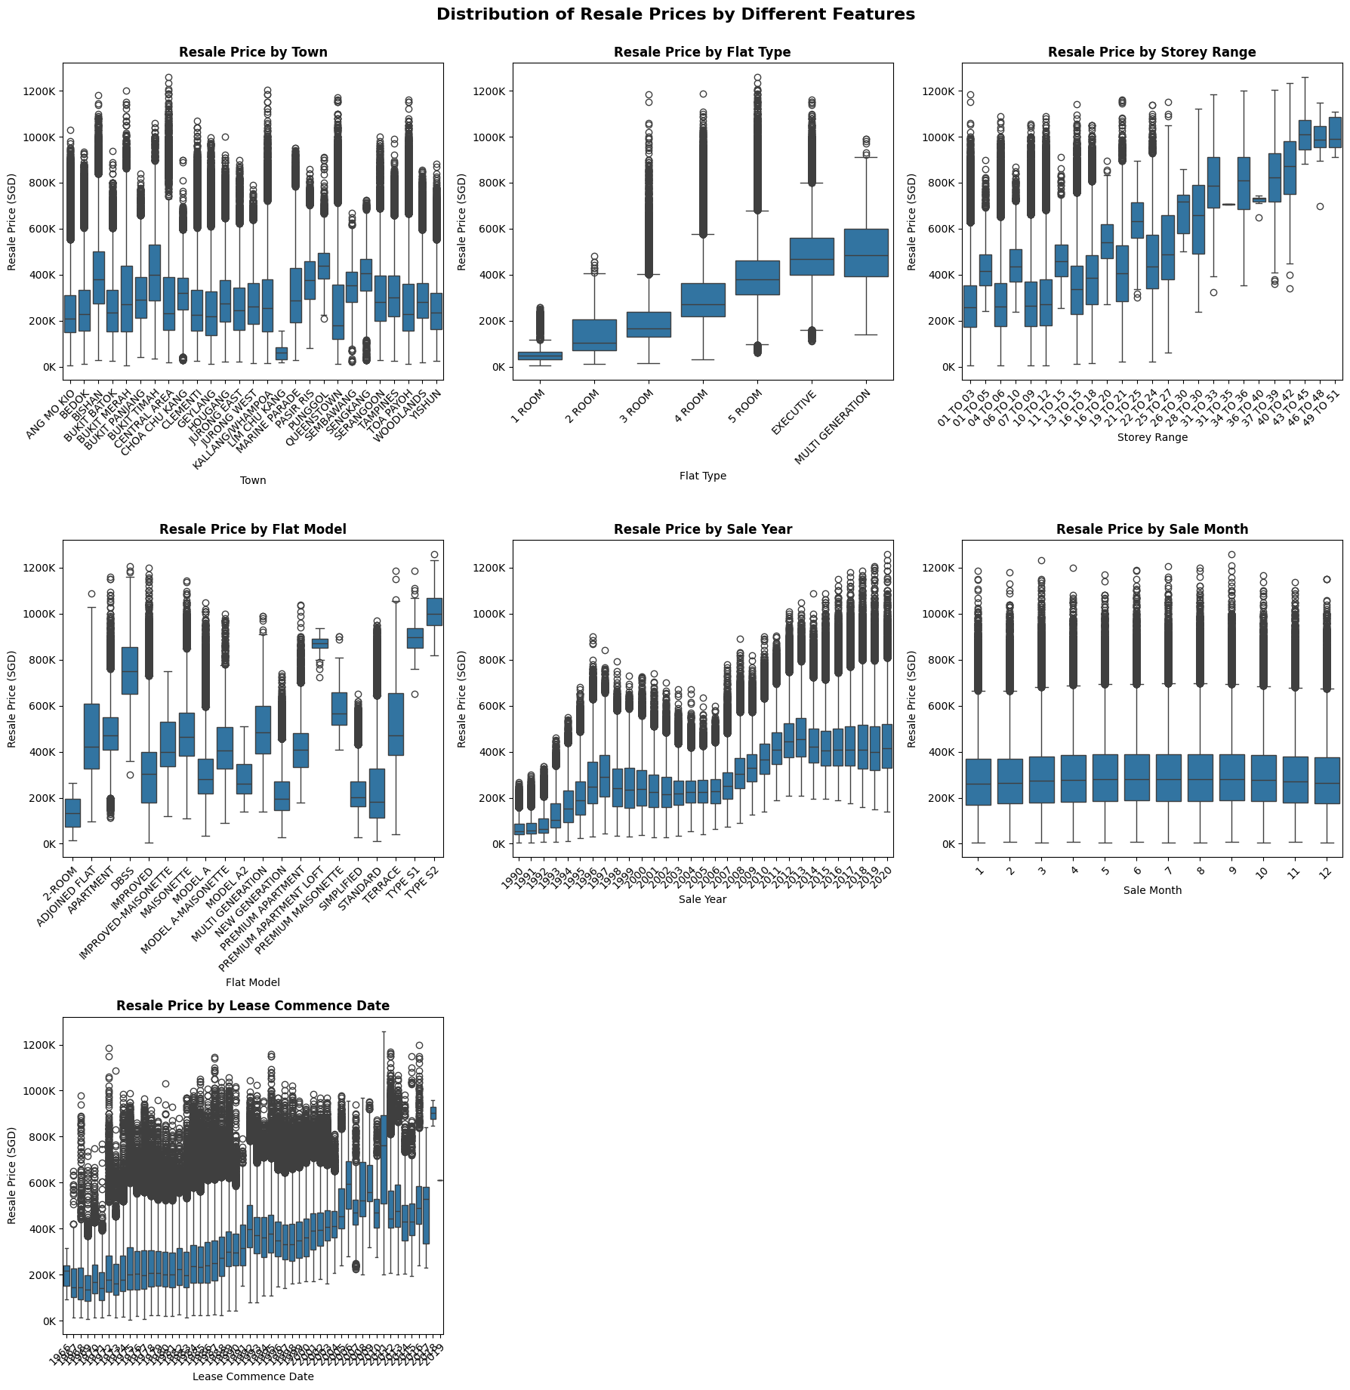
EDA
There are some clear patterns especially with flat type and storey range.
Flat model and town also affects prices.
Over the years, resale price increases.
The more recent the lease commence date, the higher the price

Slide 5
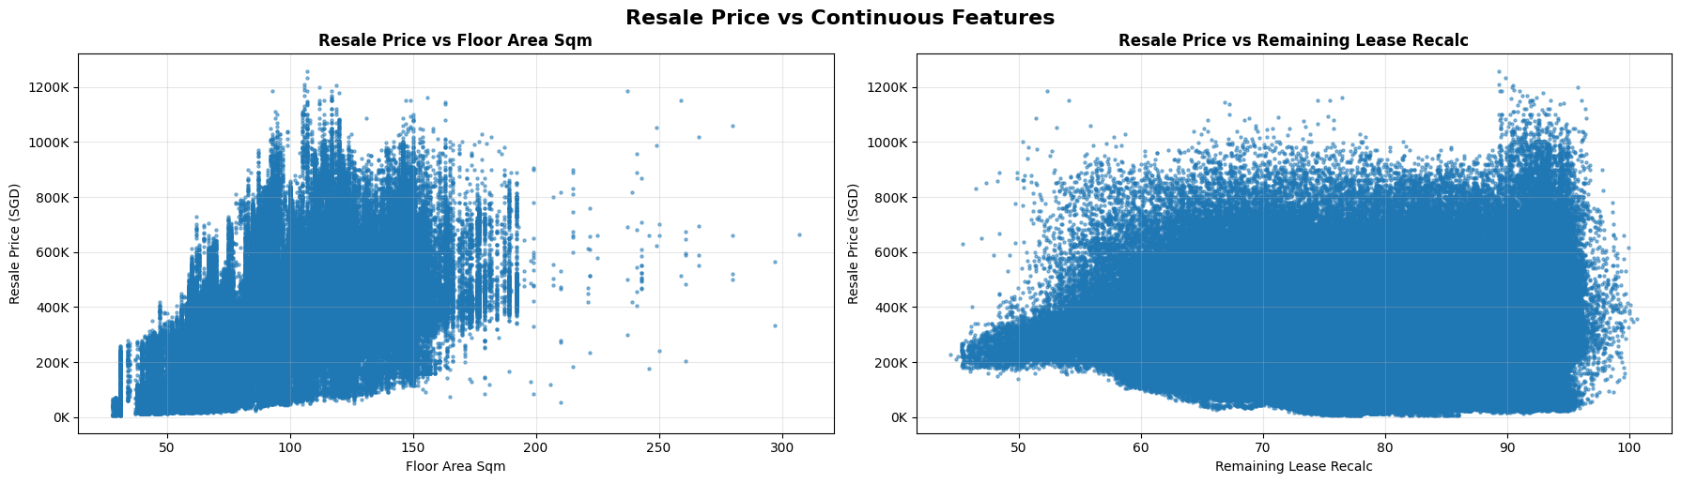
EDA
Prices increase with floor area and remaining lease.
Relationship is not as clear as the categorical values.

Slide 6
Data Preparation
I recalculated remaining lease for all data points, even though some of them have it provided.
This is to standardize the calculation method.
There are limitations to my method as it makes some assumptions about lease date and date of data point.
For data points that have remaining lease already, there are some differences, so my method is not perfect.

Slide 7
Data Preparation
Different encoding is performed on different features
  Flat_type and storey_range is Ordinal Encoded because there is an order to these values
  Town and flat_model is One Hot Encoded because there is not necessarily and inherent order.
  Street Name is Target Encoded, with smoothing. There could be relationship between street name and resale price.
Encoding is perfomed inside cross validation only to minimize risk of data leakage.
Encoding is fitted only on train set to avoid data leakage for final model training.

Slide 8
Data Preparation
Train-test split of 90-10 is prepared. Dataset is sufficiently large that we can only use 10% as test and still have a large test set.
Target feature is converted to log scale.
This penalizes mistakes in lower-priced housing as much as high-priced housing. This is ideal in this case as we want to optimize for % error in price, rather than absolute values.

Slide 9
Task 1: Model Training
TimeSeriesSplit is used so selected pipelines can generalize better on future data.
Sample Weights are calculated to ensure less frequent flat types are not overlooked.
XGBoost model is trained and hyperparameters are optimized using Optuna and TPESampler.
Final model is trained with early stopping using the final TimeSeriesSplit.

Slide 10
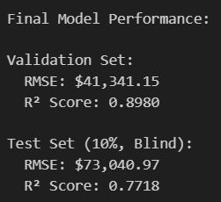
Task 1: Model Performance
There is some gap between validation (final time series split) and test set.
However, the gap is not large and R2 scores are similar.
There can be further improvements in the model through further hyperparam training.

Slide 11
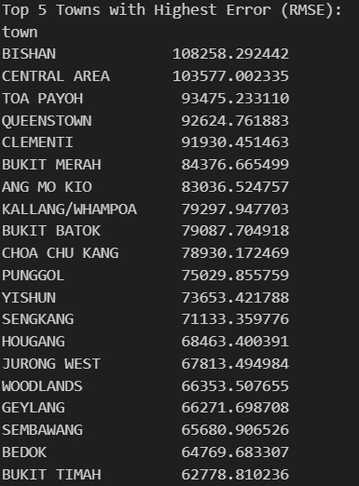
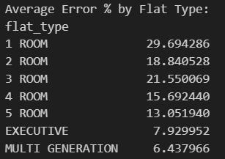
Task 1: Result Analysis
Larger absolute errors are made in more expensive towns.
Larger % errors are made in smaller flat types. This could be due to lesser representation compared to 3-room and 4-room.

Slide 12
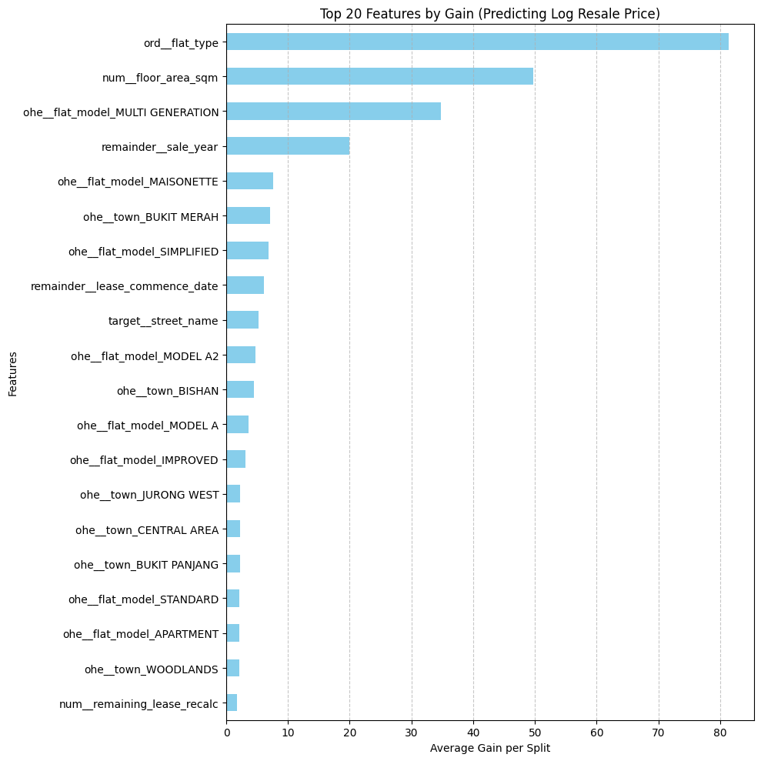
Task 1: Feature Importance
This is the Gain plot from xgboost, suggesting that flat type, floor area and sale year are the most important factors.
Flat model also seems relatively important.

Slide 13
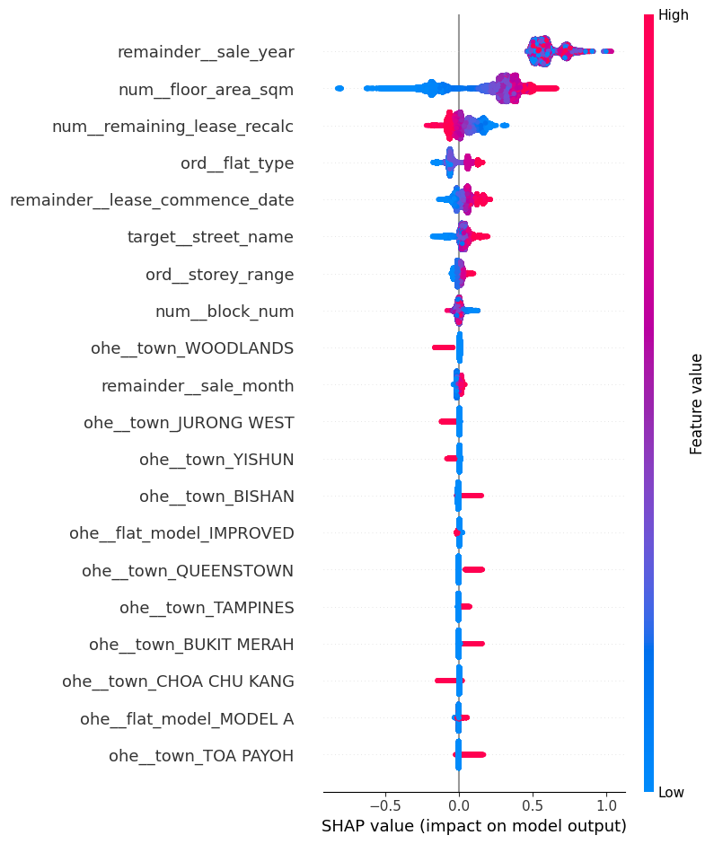
Task 1: Feature Importance
This is a SHAP Force plot
Remaining lease, floor area and flat type are also the more important features.

Slide 14
Task 1: Further Exploration
Mainly, other methods of modelling could be attempted, such as using more traditional Machine Learning models, such as Logistic Regression or Support Vector Machines, or building Neural Networks for modelling.

Slide 15
Task 2: Graph Construction
Dataset was segmented into unique (town, flat type) groups to ensure similarity comparisons are restricted to logically relevant housing sub-markets.
Chunked distance computation strategy to identify the k-nearest neighbors for each node
Gaussian kernel is applied to transform raw Euclidean distances into normalized similarity weights, using a dynamically calculated sigma based on the median distance.
The engine ensures graph consistency by converting edges to an undirected format and prunes weak connections below a specific threshold to maintain a sparse, high-quality topology.

Slide 16
Task 2: Assumptions and Limitations
Construction of the graph was based on town-flat type groupings, which may not be the best grouping for the dataset
However, I chose this based on domain knowledge of HDB property market. Location of flat is commonly the most important factor in purchase decisions, followed by flat type.
This means that a 4-room flat in Bukit Batok is very different from a 4-room flat in Tanjong Pagar.

Slide 17
Task 2: Link Analysis
A simple community detection is first run to find groups of houses that cluster together but are different from other clusters
PageRank (original method to rank websites on Google) is used to rank house connectivity
This was used to find house transactions that are highly influential on other transactions, or in other terms, can be the benchmark
Degree centrality was performed to find mainstream transactions and unique transactions
Data was normalized to compare across large and small groups

Slide 18
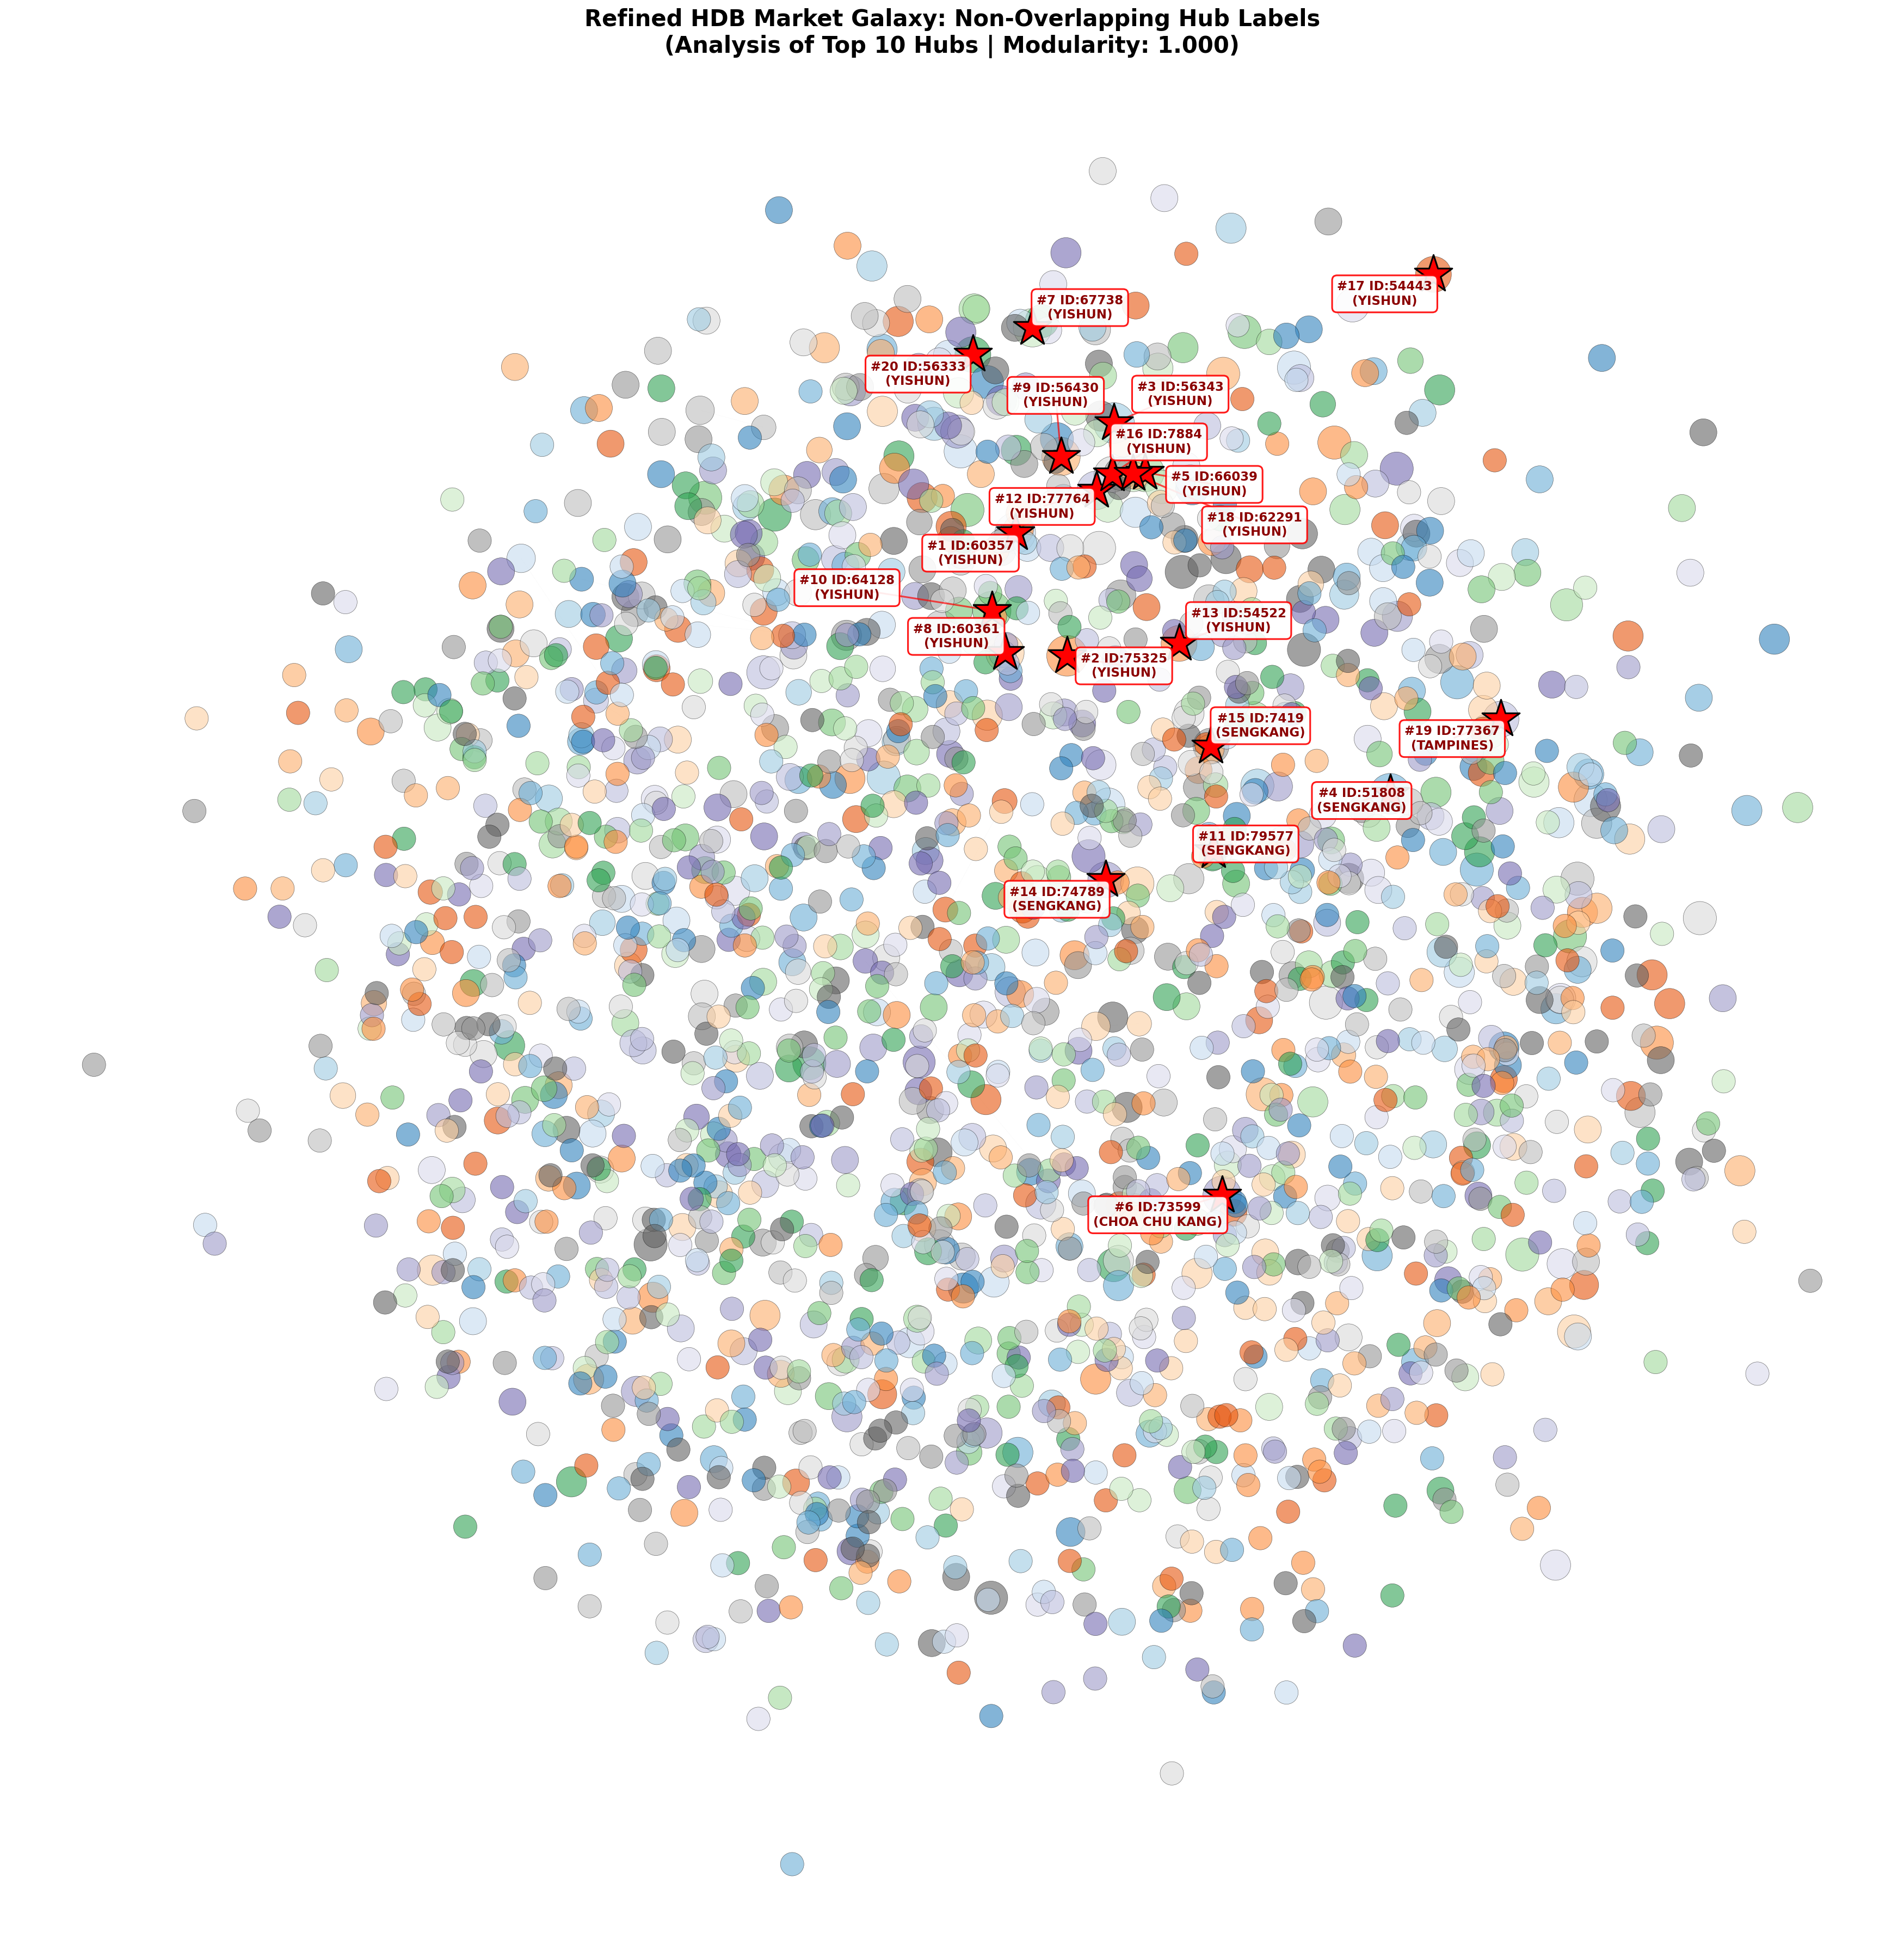
Task 2 Link Analysis results
Visualization of the graph confirms that there is a highly segmented market
There are some anchors, largely in Yishun and Sengkang, which can be seen as benchmarks for their clusters
Most properties have very little peers, indicating that there are little substitutions in the housing market
The HDB is a collection of thousands of different mini markets

Slide 19
Task 3: Link Analysis Neural Network Prediction
Train-test split is performed
Graph was built on whole dataset, but only target features for train set is fed into the neural network for training.
GraphSAGE method is used
2 layer model with 64 hidden channels
The graph is used in a final model to look at connected neighbours to leverage the similarity network to refine price prediction

Slide 20
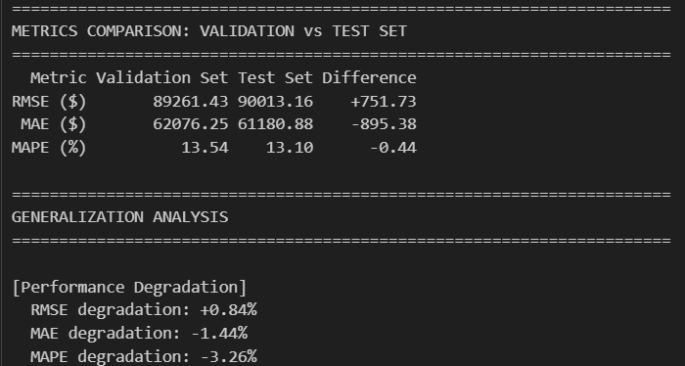
Task 3: NN results
Results between validation and test set is highly similar, which means that the model likely generalized quite well
RMSE is not as good as the XGBoost model

Slide 21
Task 3: Future work
The Neural network could be further tuned by changing the number of layers in the MLP, changing the number of hidden channels, changing the activation function and changing dropout rate.

